Slide 1
Image Processing INT3404 20 Week 4: Spatial filtering
Lecturer: Nguyen Thi Ngoc Diep, Ph.D.
Email: ngocdiep@vnu.edu.vn
Notes:
7 13h00’  13h50’ 10’
8 14h00’  14h50’ 10’
9 15h00’  15h50’

Slide 2
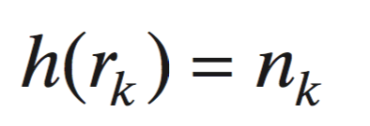
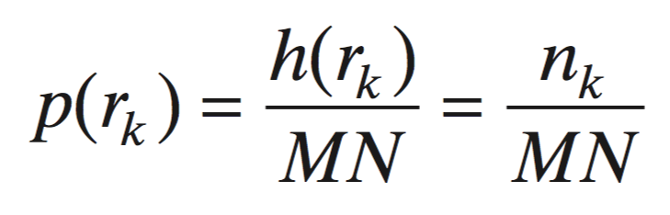
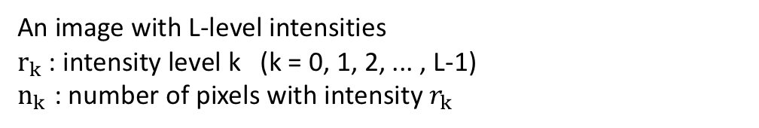
Recall week 3: Histogram
Unnormalized histogram:
An image with L-level intensities
$r_{k}$: intensity level k (k = 0, 1, 2, ... , L-1)
$n_{k}$ : number of pixels with intensity $r_{k}$
Normalized histogram:

Slide 3
Recall week 3: Histogram and image appearance

Slide 4
Recall week 3: Histogram equalization and matching
Histogram Equalization
A transformation function that generates an output image with a uniform histogram
Histogram Matching
A transformation function that generates an output image with a specified histogram
template
source

Slide 5
Schedule
Tuần | Nội dung | Yêu cầu đối với sinh viên (ngoài việc đọc tài liệu tham khảo)
1 | Giới thiệu môn học | Cài đặt môi trường: Python 3, OpenCV 3, Numpy, Jupyter Notebook
2 | Ảnh số (Digital image) – Phép toán điểm (Point operations) Làm quen với OpenCV + Python Điều chỉnh độ tương phản (Contrast adjust)– Ghép ảnh (Combining images)
3 | Histogram - Histogram equalization | Làm bài tập 1: điều chỉnh gamma tìm contrast hợp lý
4 | Phép lọc trong không gian điểm ảnh (linear processing filtering) | Thực hành ở nhà
5 | Phép lọc trong không gian điểm ảnh (linear processing filtering) (cont.) Thực hành: Cách tìm filters | Thực hành ở nhà
6 | Thực hành: Ứng dụng của histogram; Tìm ảnh mẫu (Template matching) | Bài tập mid-term
7 | Trích rút đặc trưng của ảnh Cạnh (Edge) và đường (Line) và texture | Thực hành ở nhà
8 | Các phép biến đổi hình thái (Morphological operations) | Làm bài tập 2: tìm barcode
9 | Chuyển đổi không gian – Miền tần số – Phép lọc trên miền tần số Thông báo liên quan đồ án môn học | Đăng ký thực hiện đồ án môn học
10 | Xử lý ảnh màu (Color digital image) | Làm bài tập 3: Chuyển đổi mô hình màu và thực hiện phân vùng
11 | Các phép biến đổi hình học (Geometric transformations) | Thực hành ở nhà
12 | Nhiễu – Mô hình nhiễu – Khôi phục ảnh (Noise and restoration) | Thực hành ở nhà
13 | Nén ảnh (Compression) | Thực hành ở nhà
14 | Hướng dẫn thực hiện đồ án môn học | Trình bày đồ án môn học
15 | Hướng dẫn thực hiện đồ án môn học Tổng kết cuối kỳ | Trình bày đồ án môn học

Slide 6
Week 4: Spatial filtering

Slide 7
Neighbors of a pixel
 | (x-1, y)
(x, y – 1) | (x, y) | (x, y+1)
 | (x+1, y)
(x-1, y-1) | (x-1, y) | (x-1, y+1)
(x, y – 1) | (x, y) | (x, y+1)
(x+1, y-1) | (x+1, y) | (x+1, y+1)
4 - neighbors
8 - neighbors

Slide 8
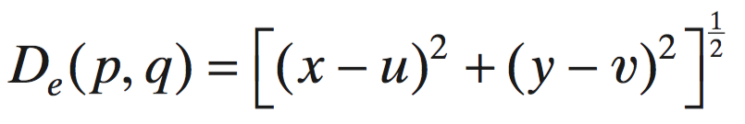
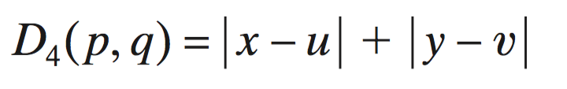
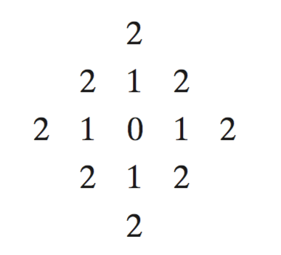
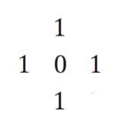
Distance between two pixels (1/2)
2 pixels p=(x, y) and q=(u,v)
Euclidean distance:
City-block distance:
Manhattan distance
All pixels that are less than or equal to some value d form a diamond centered at (x, y)
Example:
D₄ = 1 (→ 4 neighbors)
D₄ = 2

Slide 9
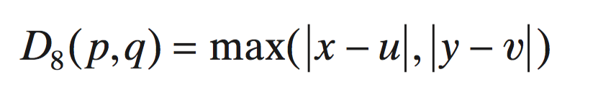
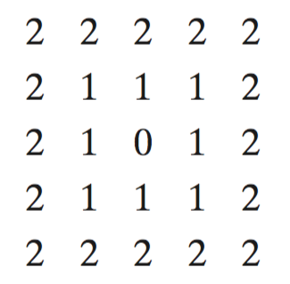
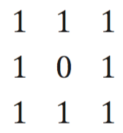
Distance between two pixels (2/2)
2 pixels p=(x, y) and q=(u,v)
Chessboard distance:
All pixels that are less than or equal some value d form a square centered at (x, y)
Example:
D₈ = 1 (→ 8 neighbors)
square size: 3x3
D₈ = 2
square size: 5x5

Slide 10
Spatial filter kernel
Also called: mask, template, window, filter, kernel
A kernel: an array whose size defines the neighborhood of operation, and whose coefficients determine the nature of the filter
Spatial filtering modifies an image by replacing the value of each pixel by a function of the values of the pixel and its neighbors

Slide 11
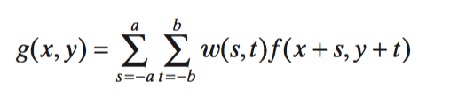
Linear spatial filtering mechanism
A linear spatial filter performs a sum-of-products operation between an image f and a filter kernel, w
Kernel center w(0,0) aligns with the pixel at location (x,y)
Kernel size: m x n
m = 2a + 1
n = 2b + 1
Image size: M x N
Linear spatial filtering:
Source: Fig. 3.28, Gonzalez

Slide 12
Spatial correlation and convolution in 1D
At the location of the impulse (1)
Source: Fig. 3.29, Gonzalez

Slide 13
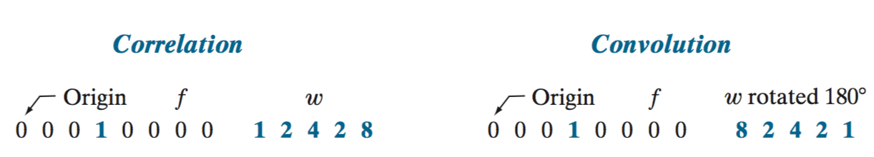
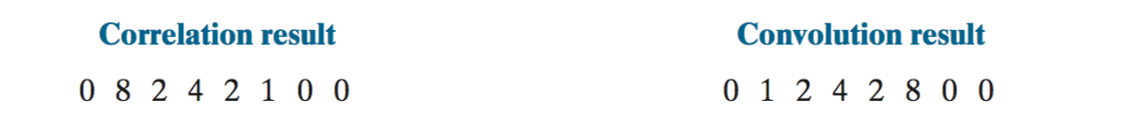
Spatial correlation and convolution in 1D
At the location of the impulse (1)
yield a copy of w,
but rotated by 180º
yield a copy of w,
by pre-rotating w before performing
shifting/sum-of-products
Source: Fig. 3.29, Gonzalez

Slide 14
Correlation and Convolution in 2D
Source: Fig. 3.30, Gonzalez

Slide 15
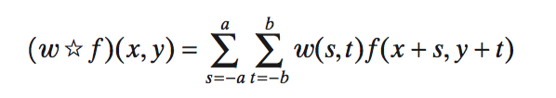
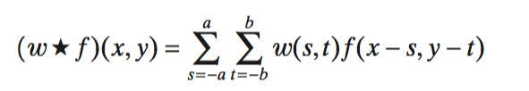
Correlation vs Convolution
Correlation
Convolution

Slide 16
Correlation vs convolution
(x-a, y-b)
 | (x, y)
(-a, -b) | (-a, 0) | (-a, +b)
(0, -b) | (0, 0) | (0, +b)
(+a, -b) | (+a, 0) | (+a, +b)
(x-a, y-b)
 | (x, y)

Slide 17
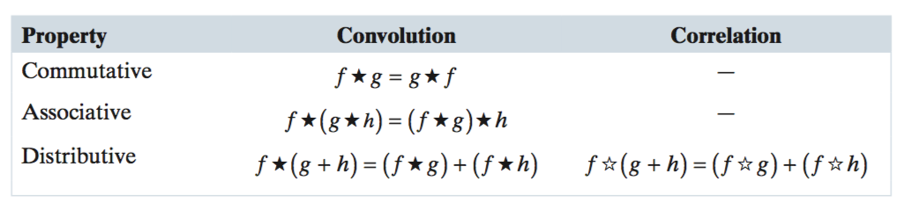
Fundamental properties of convolution and correlation

Slide 18
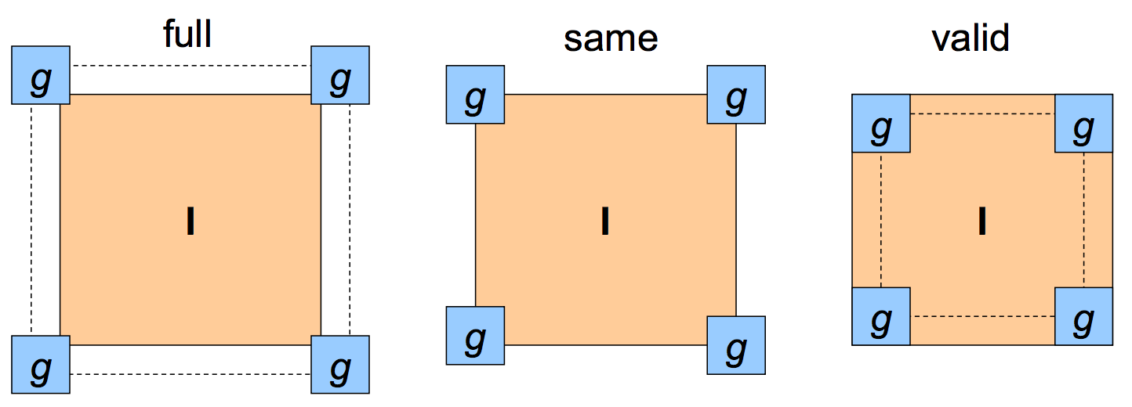
Boundary issues
Image size: MxN
Kernel size: mxn
Output:
(M + m – 1) x (N +n – 1)
M x N
(M-m+1) x (N – n + 1)

Slide 19
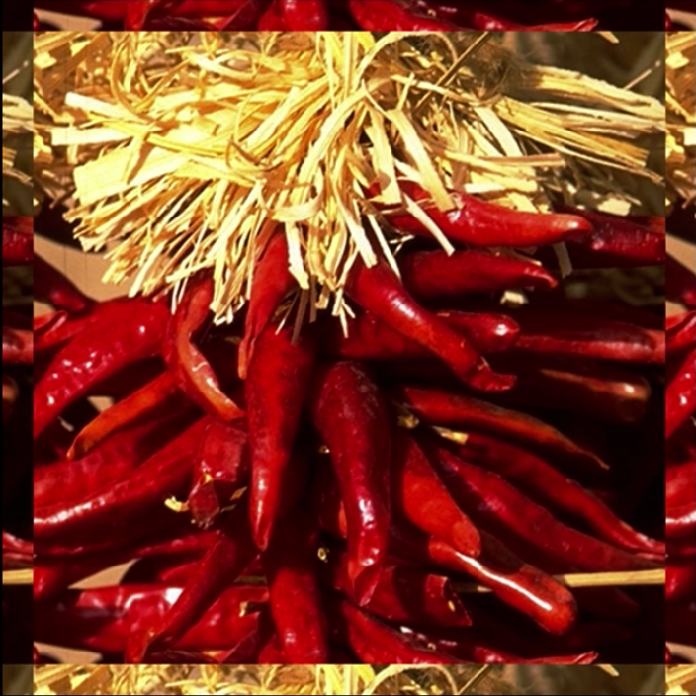
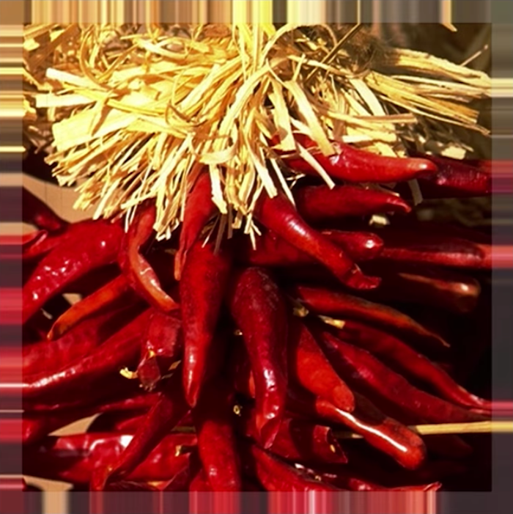
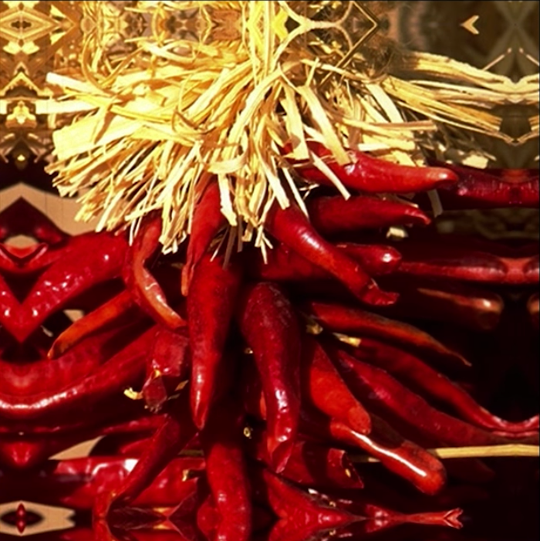
What to do around the borders
Pad a constant value (black)
Wrap around (circulate the image)
Copy edge (replicate the edges’ pixels)
Reflect across edges (symmetric)

Slide 20
Image padding
Zero (black) padding: values outside the boundary are set to zero
Mirror (or symmetric): values outside are obtained by mirror-reflecting the image across its border
Replicate padding: values outside are set equal to the nearest image border value

Slide 21
Spatial filter kernels

Slide 22
Filter design
Based on mathematical properties
E.g.: A filter that computes the average of pixels in a neighborhood blurs an image
E.g.: A filter that computes the local derivative of an image sharpens the image
Based on sampling a 2D spatial function whose shape has a desired property
E.g.: Samples from a Gaussian function to construct a weighted-average filter
Based on a specified frequency response

Slide 23
Smoothing filters
Used to reduce sharp transitions in intensity
Reduce irrelevant detail in an image (e.g., noise)
Smooth the false contours that result from using an insufficient number of intensity levels in an image
Filter kernels:
Box filter
Lowpass Gaussian filter
Order-statistic (nonlinear) filter

Slide 24
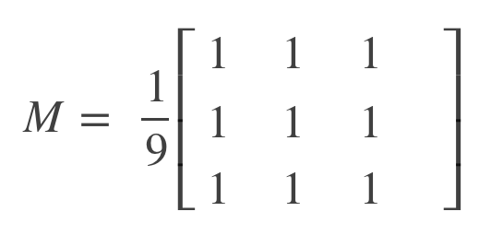
Box filter kernels
An array of 1’s
Normalizing constant
Box filters tend to favor blurring along perpendicular directions

Slide 25
Box filter example
Original image (1024x1024)
Kernel size: 3x3
Kernel size: 11x11
Kernel size: 21x21
Source: Fig. 3.33, Gonzalez

Slide 26
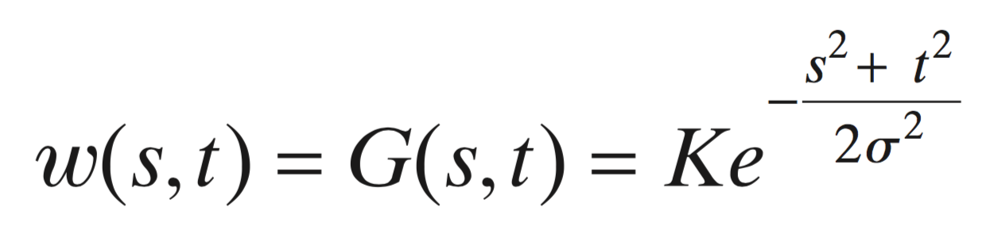
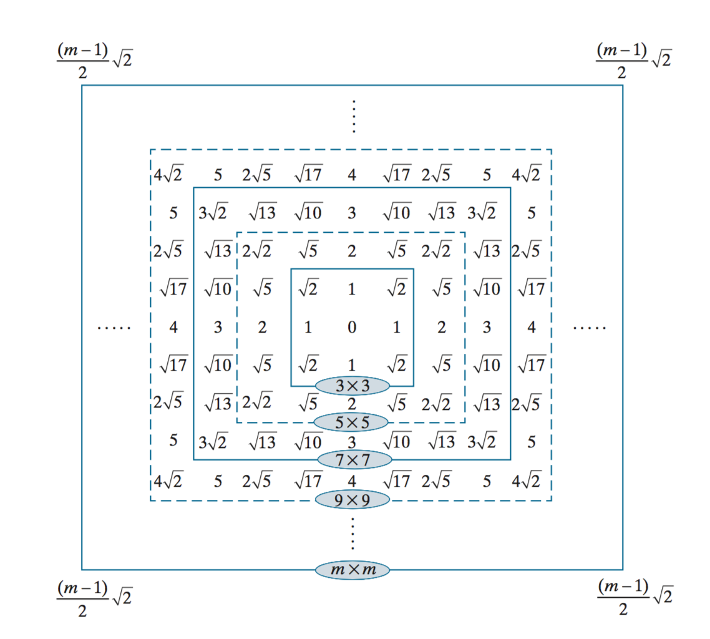
Gaussian filter kernels
When images with a high level of detail, with strong geometrical components

Slide 27

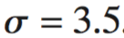
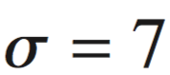
Gaussian filter example
Pattern image, 1024x1024
Gaussian filter size 21x21
Gaussian filter size 43x43
Source: Fig. 3.36. Gonzalez

Slide 28



Box vs Gaussian kernels
Original image
Box kernel, 21x21
Gaussian kernel, 21x21
Significantly less blurring

Slide 29
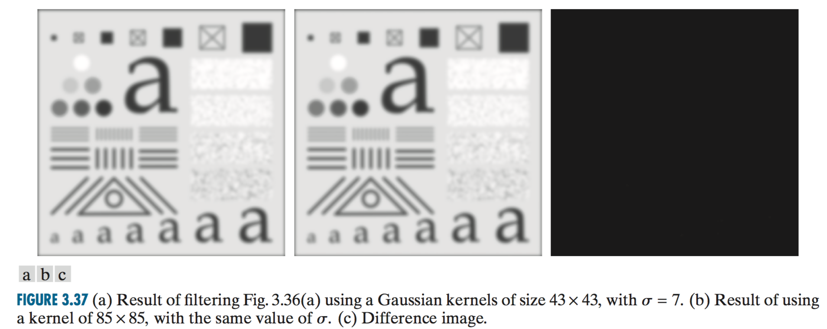
Note on Gaussian kernels
→ We get essentially the same result as if we had used an arbitrarily large Gaussian kernels

Slide 30
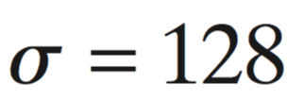
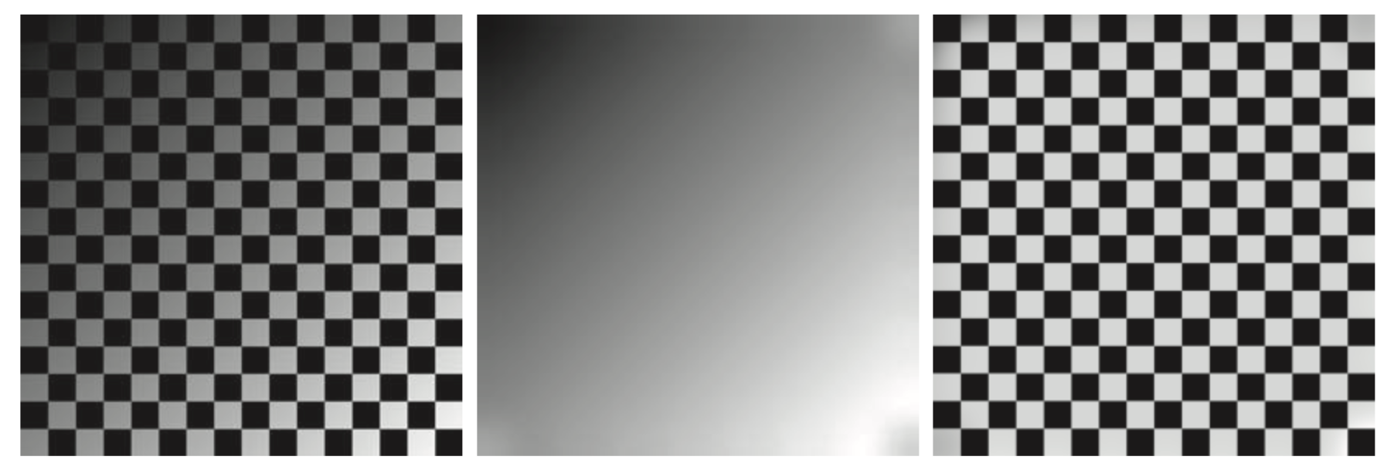
Shading correction using Gaussian filters
Gaussian kernel
Size: 512x512 (=4x square size)
K=1, (=1x square size)
2048x2048 checkerboard image
Inner square size: 128x128
Blur-out the squares
to obtain the shading pattern
Dividing original to shading pattern

Slide 31
Order-statistic filters
Nonlinear spatial filter
Based on ordering (ranking) the pixels contained in the region encompassed by the filter
Smoothing by replacing the value of the center pixel with the value determined by the ranking result
Best-known filter:
Median filter
Others:
Max filter
Min filter

Slide 32
Median filter
Replaces the value of the center pixel by the median of the intensity values in the neighborhood of that pixel
Excellent noise reduction:
Random noise
Impulse noise (salt-and-pepper noise)

Slide 33
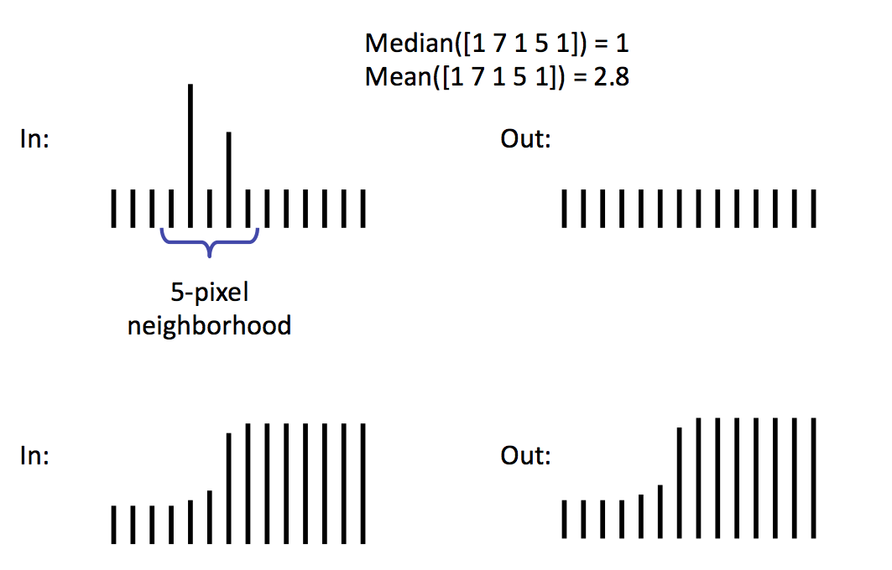
Median filter in 1D
Remove spike noise

Slide 34
Median filter in 2D
10 | 15 | 20
23 | 90 | 27
33 | 31 | 30
10 | 15 | 20
23 | 27 | 27
33 | 31 | 30
Sort
Replace
10 15 20 23 27 30 31 33 90
Median value

Slide 35
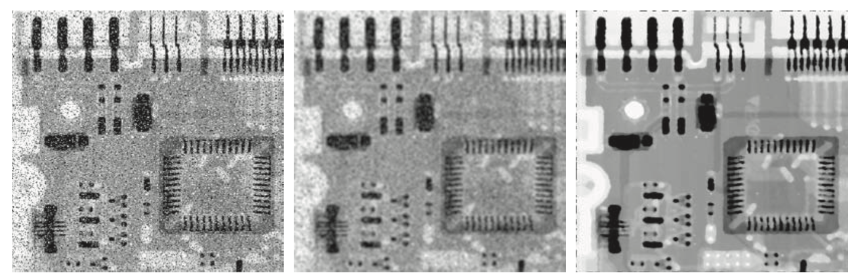
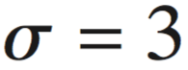
Median filter example
X-ray image of a circuit board
Applied 19x19 Gaussian kernel
Applied median kernel, 7x7
Source: Fig. 3.43, Gonzalez

Slide 36
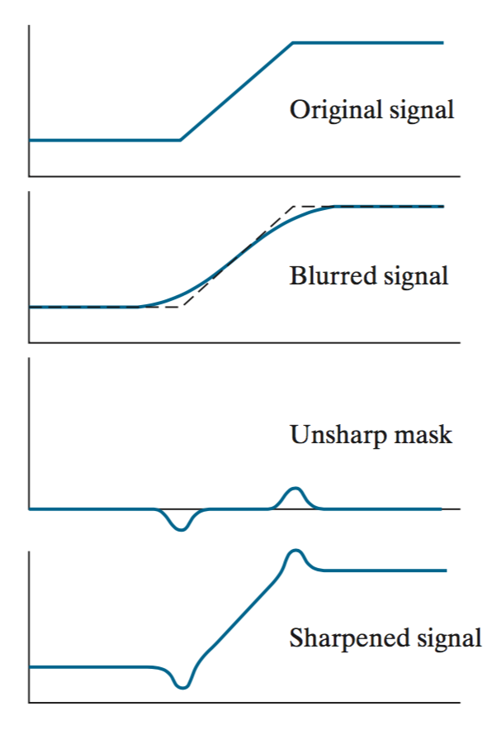
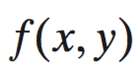
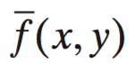
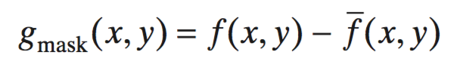
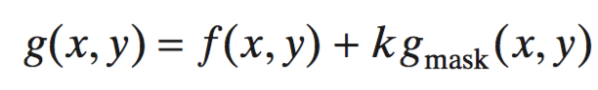
Unsharp masking
(1)
(2)
(3) = (1) – (2)
(4) = (1) + k* (3)
k = 1 → unsharp masking
k > 1 → highboost filtering

Slide 37

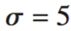

Unsharp masking example
Original image, 600x259
Gaussian kernel, 31x31,
Mask
Result of unsharp masking
Source: Fig. 3.49, Gonzalez

Slide 38
Spatial filtering with OpenCV
Check the source code

